Slide 1

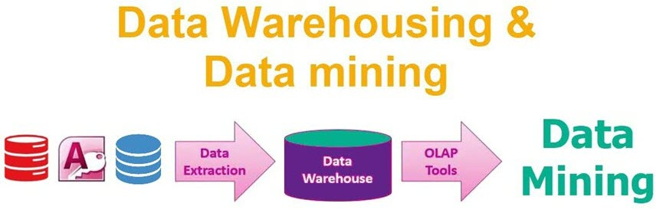

Data Warehousing
and
Data Mining
Unit-1
Introduction
D.RAMBABU
9849770917
rambabud@sreenidhi.edu.in
SREENIDHI INSTITUTE OF SCIENCE & TECHNOLOGYY
YAMNAMPET, GHATKESAR 501 301, RANGA REDDY DIST.

Slide 2
Outline
Motivation: Why data mining?
What is data mining?
KDD Process
Data Mining Architecture
Data mining functionalities
Classification of Data mining systems
Data Mining: On what kind of data?
Data mining issues

Slide 3

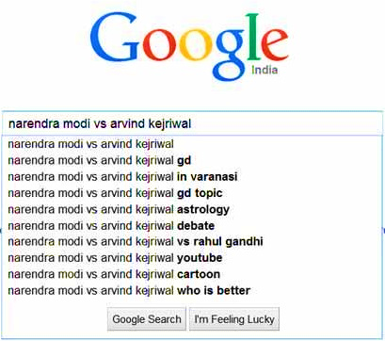

Motivation : Why Data Mining?
Data Mining
Twitter Trends
Google Trends

Slide 4
Motivation : Why Data Mining?
The Explosive Growth of Data: from terabytes to petabytes
  Data collection and data availability
    Automated data collection tools, database systems, Web, computerized society
  Major sources of abundant data
    Business: Web, e-commerce, transactions, stocks, …
    Science: Remote sensing, bioinformatics, scientific simulation, …
    Society and everyone: news, digital cameras, YouTube
We are drowning in data, but starving for knowledge!
“Necessity is the mother of invention”—Data mining—Automated analysis of massive data sets
Data Mining: Concepts and Techniques

Slide 5

Motivation : Why Data Mining?
Solution
“It has been estimated that the amount of information in the world doubles every 10 months.”
There is a tremendous increase in the amount of data recorded and stored on digital media as well as individual sources.
“Necessity is the Mother of Invention”
Data Explosion Problem
“Data Mining”
Extraction of interesting Knowledge from data in large databases

Slide 6
Why Data Mining? (Cont..)
Since the 1960’s, database and information technology has been changed systematically from primitive file processing systems to powerful database systems.
The research and development in database systems since the 1970’s has led to the development of relational database systems.
“We are drowning in data, but starving for knowledge!”
“Data rich but Information poor”

Slide 7

Why Data Mining? (Cont..)
Years | Evolution
Since 1960’s | Data collection, database creation, IMS (hierarchical database system by IBM) and network DBMS
1970s | Relational data model, relational DBMS implementation
1980s | RDBMS, advanced data models, application-oriented DBMS (spatial, scientific, engineering, etc.)
1990s | Data mining, data warehousing, multimedia databases, and web databases
2000s | Stream data management and mining, Social Networks (Facebook, etc.), web technology (XML) and global information systems
At Present | Heterogeneous database systems, big data
Every day data grows exponentially,
but these all data are really important to us??

Slide 8
Need of Data Mining
In field of Information technology we have huge amount of data available that need to be turned into useful information.
This information further can be used for various applications such as market analysis, fraud detection, customer retention, production control, science exploration etc.

Slide 9
Data Mining Applications
  Market Analysis and Management
  Corporate Analysis & Risk Management
  Fraud Detection
  Customer Retention
  Financial Banking
  Future Health care
  Criminal Investigation
  Market-Basket analysis
  Other Applications

Slide 10
Market Analysis and Management
Following are the various fields of market where data mining is used:
Customer Profiling - Data Mining helps to determine what kind of people buy what kind of products.
Identifying Customer Requirements - Data Mining helps in identifying the best products for different customers. It uses prediction to find the factors that may attract new customers.
Cross Market Analysis - Data Mining performs Association/correlations between product sales.
Target Marketing - Data Mining helps to find clusters of model customers who share the same characteristics such as interest, spending habits, income etc
Determining Customer purchasing pattern - Data mining helps in determining customer purchasing pattern
Providing Summary Information - Data Mining provide us various multidimensional summary reports

Slide 11
Corporate Analysis & Risk Management
Following are the various fields of Corporate Sector where data mining is used:
Finance Planning and Asset Evaluation - It involves cash flow analysis and prediction, contingent claim analysis to evaluate assets.
Resource Planning - It involves summarizing and comparing the resources and spending.
Competition - It involves monitoring competitors and market directions.

Slide 12
Fraud Detection
Data Mining is also used in fields of credit card services and telecommunication to detect fraud. In fraud telephone call it helps to find destination of call, duration of call, time of day or week. It also analyze the patterns that deviate from an expected norms.
Other Applications
Data Mining also used in other fields such as sports, astrology and Internet Web Surf-Aid.

Slide 13
Data Mining: Confluence of Multiple Disciplines
Database
Technology
Statistics
Machine
Learning
Data Mining
Visualization
Pattern
Recognition
Other
Disciplines
Algorithm
Data Mining: Concepts and Techniques

Slide 14
Data mining overlaps with many disciplines
Statistics
Machine Learning
Information Retrieval (Web mining)
Distributed Computing
Database Systems

Slide 15


What Is Data Mining?
Data mining (knowledge discovery from data)
Extracting or “mining” knowledge from large amount of data
  Extraction of interesting (non-trivial, implicit, previously unknown and potentially useful) patterns or knowledge from huge amount of data
  Data mining: a misnomer?
Alternative names
  Knowledge Discovery (mining) in Databases (KDD), knowledge extraction, data/pattern analysis, data archeology, data dredging, information harvesting, business intelligence, etc.
Watch out: Is everything “data mining”?
  Simple search and query processing
  (Deductive) expert systems
Data Mining: Concepts and Techniques

Slide 16





What is Data Mining?
Data mining refers to extracting or “mining” knowledge from large amounts of data.
“Knowledge mining from data” or “Knowledge mining”
“Extract knowledge from large data or databases”
“Knowledge discovery from database (KDD)”

Slide 17
What is Data Mining? (Cont..)
It is the computational process of discovering patterns in large data sets involving methods at the intersection of artificial intelligence, machine learning, statistics, and database systems.
The overall goal of the data mining process is to extract information from a large data sets and transform it into an understandable structure for further use.

Slide 18
What is Data Mining? (Cont..)
Data → Knowledge → Action → Goal
Netflix collects user ratings of movies (data) => What types of movies you will like (knowledge) => Recommend new movies to you (action) => Users stay with Netflix (goal)
Gene sequences of cancer patients (data) => Which genes lead to cancer? (knowledge) => Appropriate treatment (action) => Save life (goal)
Road traffic (data) => Which road is likely to be congested? (knowledge) => Suggest better routes to drivers (action) => Save time and energy (goal)

Slide 19
KDD (Knowledge Discovery in Databases) Process
Knowledge discovery in databases is a process of an iterative sequence of the following steps:
Data Cleaning.
Data integration.
Data selection.
Data transformation.
Data mining.
Pattern evaluation.
Knowledge presentation.

Slide 20
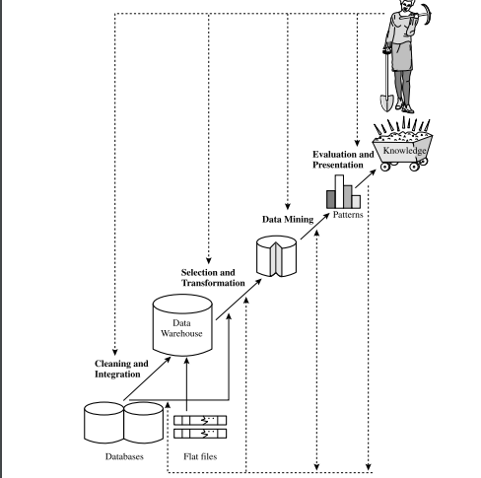
Fig :KDD (Knowledge Discovery in Databases) Process

Slide 21
7 steps in KDD process
Data Cleaning: to remove noise and inconsistent data
Data integration : where multiple data sources may be combined
Data selection: where data relevant to the analysis task are retrieved from the data base.
Data transformation: where data are transformed and consolidated into forms appropriate for mining by performing summary or aggregation operations.
Data mining: an essential process where intelligent methods are applied to extract data patterns
Pattern evaluation: to identify the truly interesting patterns representing knowledge based on interestingness measures.
Knowledge presentation: where visualization and knowledge representation techniques are used to present mined knowledge to users

Slide 22
Data Mining Architecture
Graphical User Interface
Pattern Evaluation
Knowledge Base
Data Mining Engine
Database or Data Warehouse Server
Cleaning, Integration & Selection
Database
Data Warehouse
WWW
Other Info Repositories

Slide 23
Data Source:
The actual source of data is the Database, data warehouse, World Wide Web (WWW), text files, and other documents.
You need a huge amount of historical data for data mining to be successful. Organizations typically store data in databases or data warehouses.
Data warehouses may comprise one or more databases, text files, spreadsheets, or other repositories of data. Sometimes, even plain text files or spreadsheets may contain information.
Another primary source of data is the World Wide Web or the internet.

Slide 24
Cleaning, Integration& Selection(Different processes):
Before passing the data to the database or data warehouse server, the data must be cleaned, integrated, and selected. As the information comes from various sources and in different formats, it can't be used directly for the data mining procedure because the data may not be complete and accurate. So, the first data requires to be cleaned and unified.
More information than needed will be collected from various data sources, and only the data of interest will have to be selected and passed to the server. These procedures are not as easy as we think. Several methods may be performed on the data as part of selection, integration, and cleaning.

Slide 25
Database, data warehouse, World Wide Web, or other information repository:
This is one or a set of databases, data warehouses, spreadsheets, or other kinds of information repositories.
Data cleaning and data integration techniques may be performed on the data.
The database or data warehouse server consists of the original data that is ready to be processed.
Database or data warehouse server:
The database or data warehouse server is responsible for fetching the relevant data, based on the user’s data mining request.

Slide 26
Knowledge base:
  The knowledge base is helpful in the entire process of data mining.
  Knowledge base is the domain knowledge that is used to guide the search or evaluate the interestingness of resulting patterns.
  The knowledge base may even contain user views and data from user experiences that might be helpful in the data mining process.
  Such knowledge can include concept hierarchies, used to organize attributes or attribute values into different levels of abstraction.
  Knowledge is such as user beliefs, which can be used to assess a pattern’s interestingness based on its unexpectedness, may also be included.

Slide 27
Data Mining Engine:
  It is essential to the data mining system and ideally consists of a set of functional modules (knowledge) for different tasks such as…
    Characterization
    Association
    Correlation analysis
    Classification & prediction
    Cluster analysis
    Outlier analysis
we can say data mining is the root of our data mining architecture. It comprises instruments and software used to obtain insights and knowledge from data collected from various data sources and stored within the data warehouse.

Slide 28
Pattern Evaluation Module:
The Pattern evaluation module is primarily responsible for the measure of investigation of the pattern by using a threshold value.
This component typically employs interestingness measures and interacts with the data mining modules so it is focus in the search towards interesting patterns.
The pattern evaluation module integrated with the mining module, depending on the implementation of the data mining method used.

Slide 29
User interface:
This module communicates between users and the data mining system, allowing the user to interact with the system by specifying a data mining query or task, providing information to help focus the search, and performing exploratory data mining based on the intermediate data mining results.

Slide 30
Data Mining: On What Kinds of Data?
Database-oriented data sets and applications
  Relational database, data warehouse, transactional database
Advanced data sets and advanced applications
  Data streams and sensor data
  Time-series data, temporal data, sequence data (incl. bio-sequences)
  Structure data, graphs, social networks and multi-linked data
  Object-relational databases
  Heterogeneous databases and legacy databases
  Spatial data and spatiotemporal data
  Multimedia database
  Text databases
  The World-Wide Web
Data Mining: Concepts and Techniques

Slide 31
Relational Databases:
It is a collection of tables
These databases can be accessed by database queries
Customer data analysis, sales forecasting
Data Warehouse:
It is a repository of information collected from multiple sources, stored under uniform schema, and which usually resides at a single site
It is constructed via a process of data cleaning, data integration, data transformation, data loading and periodic data refreshing.
It is usually modeled by a multidimensional data cube.
Business intelligence, trend analysis
Data Mining: Concepts and Teciques

Slide 32
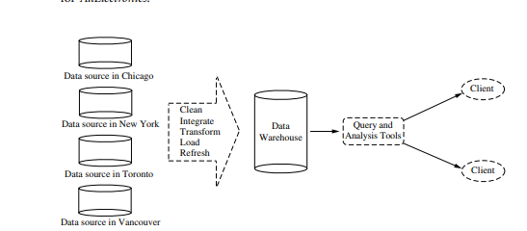

Slide 33
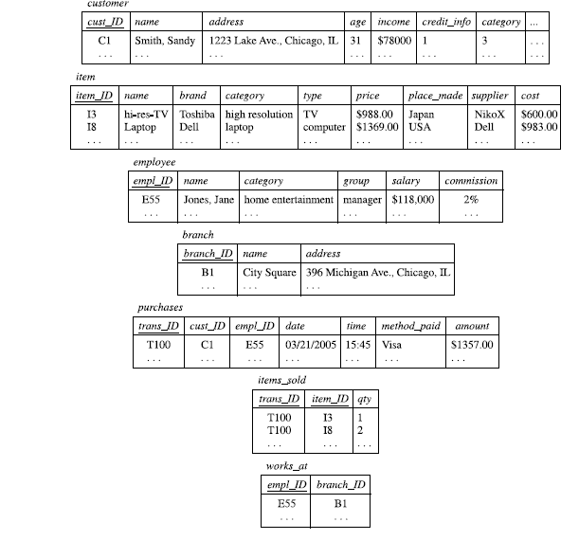

Slide 34
What is the difference between a datawarehouse and a data mart?”
A data warehouse collects information about subjects that span an entire organization, and thus its scope is enterprise-wide.
A data mart, on the other hand, is a department subset of a data warehouse. It focuses on selected subjects,and thus its scope is department-wide.

Slide 35
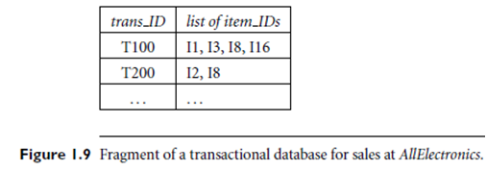
Transactional Databases:
A transactional database consists of a file where each record represents a transaction.
A transaction typically includes a unique transaction identity number (trans ID) and a list of the items making up the transaction (such as items purchased in a store).
Market basket analysis, fraud detection
Data Mining: Concepts and Techniques

Slide 36
Data streams and sensor Data: Continuous, real-time data (e.g., IoT devices, weather sensors) Anomaly detection, real-time monitoring
Structured Data, Graphs, Social Networks :Data with defined structure and relationships (e.g., graphs, friends in a network) Social media analysis, fraud detection
Data Mining: Concepts and Techniques

Slide 37
Object relational databases: constructed based on object-relational data model.Complex applications like CAD, medical systems.
Spatial databases: contain spatial related information like geographic databases, medical and satellite image databases. Spatial data may be represented in raster format. Maps in vector format. Location-based services, traffic analysis
Temporal databases and Time-series databases:
They store time-related data. Temporal databases store relational data that include time-related attributes(involve several timestamps). A time series databases store sequence of values that change with time. Forecasting, sequence pattern mining
Data Mining: Concepts and Techniques

Slide 38
Text Databases and Multimedia Databases:
Text databases are databases that contain word descriptions for objects like bug reports, summary reports.
Text mining, sentiment analysis
Multimedia databases store image, audio, and video data. Image recognition, video content mining
For multimedia database mining, storage and search techniques need to be integrated with standard data mining methods(like construction of data cubes..)
Heterogeneous Databases and Legacy Databases:
A legacy database is a group of heterogeneous databases that combine different kinds of data systems. data migration
World Wide Web:
Understanding user access patterns(mining path traversal patterns) Web mining, recommendation systems
Data Mining: Concepts and Techniques

Slide 39
Classification of Data Mining Systems
Different views lead to different classifications
  Data view: Kinds of data to be mined
  Knowledge view: Kinds of knowledge to be discovered
  Method view: Kinds of techniques utilized
  Application view: Kinds of applications adapted
Data Mining: Concepts and Techniques

Slide 40
Classification of Data Mining Systems
Classification according to the Kinds of Data bases mined
  Relational, data warehouse, transactional, stream, object-oriented/relational( according to data model), spatial, time-series, text, multi-media, heterogeneous, legacy, WWW (according to type of data handled).
Classification according to the Kinds of Knowledge mined
  Characterization, discrimination, association, classification, clustering, trend/deviation, outlier analysis, etc.
  Multiple/integrated functions and mining at multiple levels
Data Mining: Concepts and Techniques

Slide 41
Classification according to the Kinds of Techniques utilized.
These techniques can be assessed based on the involvement of user interaction involved or the methods of analysis employed.
  Database-oriented, data warehouse (OLAP), machine learning, statistics, visualization, etc.
Classification according to the Applications adapted:
  Retail, telecommunication, banking, fraud analysis, bio-data mining, stock market analysis, text mining, Web mining, etc.

Slide 42
Data Mining Functionalities
Data mining functionalities are used to specify the kind of patterns to be found in data mining tasks .
Data mining tasks can be classified into two categories:
  Descriptive
  Predictive
Descriptive :To describe or summarize the general characteristics or patterns in existing data without making predictions.(What is happening?)
  These tasks present the general properties of data stored in database.
  involves finding interesting patterns or associations relating to data
  E.g. : Cluster, Association, correlation, trends etc.
Predictive :predict future values or unknown values
  These tasks predict the value of one attribute on the bases of values of other attributes.(What is likely to happen?)
  involves the prediction(regression) and classification of the data gathered in past or current
  E.g. : Customer/Product prediction at sales store. Predicting whether a customer will buy a product based on past purchases.

Slide 43
Data Mining Functionalities
The following are the functionalities and the kinds of pattern they discover:
Class/Concept Description: Characterization and Discrimination
Association Analysis
Correlation Analysis
Classification and Prediction
Cluster Analysis
Outlier Analysis
Data Mining: Concepts and Techniques

Slide 44
Class/Concept Description: Characterization and Discrimination
Data can be associated with classes or concepts.
For example, in the AllElectronics store, classes of items for sale include computers and printers, and concepts of customers include bigSpenders and budgetSpenders.
It can be useful to describe individual classes and concepts in summarized, concise, and yet precise terms. Such descriptions of a class or a concept are called class/concept descriptions
Data Mining: Concepts and Techniques

Slide 45
These descriptions can be derived via
Data characterization, by summarizing the data of the class under study
Data discrimination, by comparison of the target class with one or a set of comparative classes (often called the contrasting classes), or
both data characterization and discrimination.
Data characterization is a summarization of the general characteristics or features of a target class of data. The data corresponding to the user-specified class are typically collected by a database query.
For example, to study the characteristics of software products whose sales increased by 10% in the last year, the data related to such products can be collected by executing an SQL query
Data discrimination is a comparison of the general features of target class data objects with the general features of objects from one or a set of contrasting classes.

Slide 46
The target and contrasting classes can be specified by the user, and the corresponding data objects retrieved through database queries.
For example, the user may like to compare the general features of software products whose sales increased by 10% in the last year with those whose sales decreased by at least 30% during the same period.

Slide 47
Data Mining Functions: (2) Association and Correlation Analysis
Frequent patterns (or frequent item sets) : patterns that occur frequently in data.
There are many kinds of frequent patterns, including itemsets, subsequences, and substructures.
A frequent itemset typically refers to a set of items that frequently appear together in a transactional data set, such as milk and bread.
A frequently occurring subsequence, such as the pattern that customers tend to purchase first a PC, followed by a digital camera, and then a memory card, is a (frequent) sequential pattern.
A substructure can refer to different structural forms, such as graphs, trees, or lattices, which may be combined with itemsets or subsequences. If a substructure occurs frequently, it is called a (frequent) structured pattern
Data Mining: Concepts and Techniques

Slide 48
  Association analysis. Suppose, as a marketing manager of AllElectronics, you would like to determine which items are frequently purchased together within the same transactions. An example of such a rule, mined from the AllElectronics transactional database, is
  buys(X, “computer”) ⇒ buys(X, “software”) [support = 1%,confidence = 50%]
  where X is a variable representing a customer. A confidence, or certainty, of 50% means that if a customer buys a computer, there is a 50% chance that she will buy software as well. A 1% support means that 1% of all of the transactions under analysis showed that computer and software were purchased together.
  This association rule involves a single attribute or predicate (i.e., buys) that repeats.
  Association rules that contain a single predicate are referred to as single-dimensional association rules.

Slide 49
A data mining system may find association rules like
age(X, “20...29”)∧income(X, “20K...29K”) ⇒ buys(X, “CD player”) [support = 2%, confidence = 60%]
The rule indicates that of the AllElectronics customers under study, 2% are 20 to 29 years of age with an income of 20,000 to 29,000 and have purchased a CD player 24 .
There is a 60% probability that a customer in this age and income group will purchase a CD player.
Note that this is an association between more than one attribute, or predicate (i.e., age, income, and buys). the above rule can be referred to as a multidimensional association rule.
Typically, association rules are discarded as uninteresting if they do not satisfy both a minimum support threshold and a minimum confidence threshold.

Slide 50
Correlation Analysis
Correlation is a mathematical technique for determining whether and how strongly two attributes is related to one another. It refers to the various types of data structures, such as trees and graphs, that can be combined with an item set or subsequence. It determines how well two numerically measured continuous variables are linked.

Slide 51
Data Mining Functions: (3) Classification and Prediction
Classification
Classification is the process of finding or creating a model that describes(identify) and distinguishes(separate) data classes or concepts,for the purpose of being able to use the model to predict the class of objects whose class label is unknown. The derived model is based on the analysis of a set of training data (i.e., data objects whose class label is known)
  Construct models (functions) based on some training examples
  Describe and distinguish classes or concepts for future prediction
    E.g., classify countries based on (climate), or classify cars based on (gas mileage)
Prediction: models continuous-valued functions. That is, it is used to predict missing or unavailable numerical data values rather than class labels.
  Predict some unknown or missing numerical values . Regression analysis is a statistical methodology that is most often used for numeric prediction
Typical methods
  Decision trees, naïve Bayesian classification, support vector machines, neural networks, rule-based classification, pattern-based classification, logistic regression, …
Typical applications:
  Credit card fraud detection, direct marketing, classifying stars, diseases, web-pages, …
Data Mining: Concepts and Techniques

Slide 52
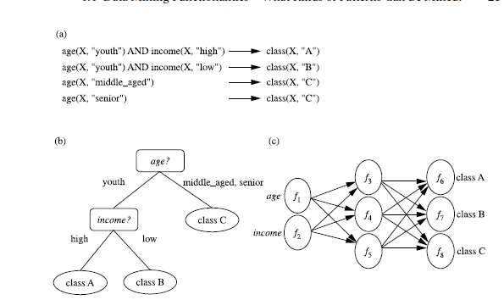
A classification model can be represented in various forms, such as (a) IF-THEN rules,
(b) a decision tree, or a (c) neural network.

Slide 53
Data Mining Functions: (4) Cluster and Outlier Analysis
Whereas classification predicts categorical (discrete, unordered) labels, prediction models continuous-valued functions. That is, it is used to predict missing or unavailable numerical data values rather than class labels.
Cluster analysis Unlike classification and prediction, which analyzes class-labeled data objects, without consulting a known class label.
  Unsupervised learning (i.e., Class label is unknown)
  Group data to form new categories (i.e., clusters), e.g., cluster houses to find distribution patterns
  Principle: Maximizing intra-class similarity & minimizing interclass similarity
Data Mining: Concepts and Techniques

Slide 54
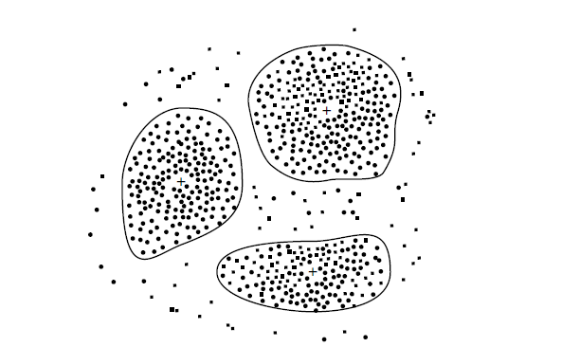
In general, the class labels are not present in the training data simply because they are
not known to begin with. Clustering can be used to generate such labels. The objects are clustered or grouped based on the principle of
maximizing the intraclass similarity and minimizing the interclass similarity.
That is, clusters of objects are formed so that objects within a cluster have high similarity in comparison to one another, but are very dissimilar to objects in other clusters.
Each cluster that is formed can be viewed as a class of objects,from which rules can be derived.

Slide 55
Outlier analysis
  A database may contain data objects that do not comply with the general behavior or model of the data. These data objects are outliers.
  Most data mining methods discard outliers as noise or exceptions. However, in some applications such as fraud detection, the rare events can be more interesting than the more regularly occurring ones. The analysis of outlier data is referred to as outlier mining
  Methods: by product of clustering or regression analysis, …
  Useful in fraud detection, rare events analysis
Evolution analysis. Evolution Analysis pertains to the study of data sets that change over time.
Suppose that you have the major stock market (time-series) data of the last several years available from the New York Stock Exchange and you would like to invest in shares of high-tech industrial companies.
A data mining study of stock exchange data may identify stock evolution regularities for overall stocks and for the stocks of particular companies. Such regularities may help predict future trends in stock market prices, contributing to your decision making regarding stock investments

Slide 56
Are All of the Patterns Interesting?
A data mining system has the potential to generate thousands or even millions of patterns, or rules, then “are all of the patterns interesting?” Typically not—only a small fraction of the patterns potentially generated would actually be of interest to any given user.
What makes a pattern interesting?
Can a data mining system generate all of the interesting patterns?
Can a data mining system generate only interesting patterns?”
To answer the first question, a pattern is interesting if it is easily understood by humans, (2)valid on new or test data with some degree of certainty, potentially useful, and novel.
A pattern is also interesting if it validates a hypothesis that the user sought to confirm. An interesting pattern represents knowledge.
Several objective measures of pattern interestingness exist.
An association rule of the form X=>Y is rule support, representing the percentage of transactions from a transaction database that the given rule satisfies. i.e P(X U Y)
Another objective measure for association rule is confidence, which assesses the degree of certainty of detected association. This is taken to be conditional probability P(Y|X) i.e., the probability that a T containing X also contains Y.
Each interesting measure is associated with a threshold, which may be controlled by the user.
Data Mining: Concepts and Techniques

Slide 57
Data Mining Task Primitives
A data mining task can be specified in the form of a data mining query, which is input to the data mining system. A data mining query is defined in terms of data mining task primitives. These primitives allow the user to interactively communicate with the data mining system during discovery to direct the mining process or examine the findings from different angles. The data mining primitives specify the following
1. Set of task-relevant data to be mined.
2. Kind of knowledge to be mined.
3. Background knowledge to be used in the discovery process.
4. Interestingness measures and thresholds for pattern evaluation.
5. Representation for visualizing the discovered patterns.
Data Mining: Concepts and Techniques

Slide 58
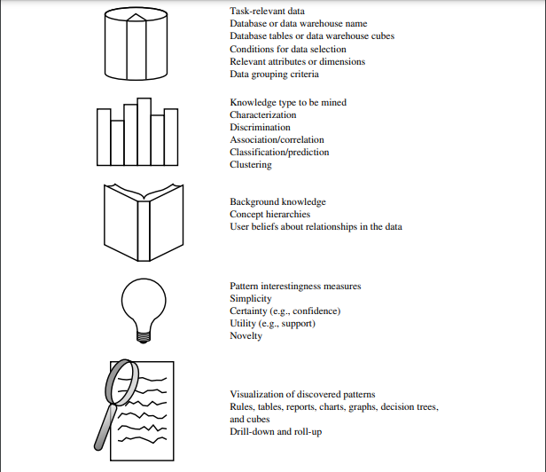

Slide 59
Data Mining Task Primitives
1. The set of task-relevant data to be mined
This specifies the portions of the database or the set of data in which the user is interested. This includes the database attributes or data warehouse dimensions of interest (the relevant attributes or dimensions).
2. The kind of knowledge to be mined
This specifies the data mining functions to be performed, such as characterization, discrimination, association or correlation analysis, classification, prediction, clustering, outlier analysis, or evolution analysis.
3. The background knowledge to be used in the discovery process
This knowledge about the domain to be mined is useful for guiding the knowledge discovery process and evaluating the patterns found. Concept hierarchies are a popular form of background knowledge, which allows data to be mined at multiple levels of abstraction.
Data Mining: Concepts and Techniques

Slide 60
Data Mining Task Primitives
4. The interestingness measures and thresholds for pattern evaluation
Different kinds of knowledge may have different interesting measures. They may be used to guide the mining process or, after discovery, to evaluate the discovered patterns. For example, interesting measures for association rules include support and confidence. Rules whose support and confidence values are below user-specified thresholds are considered uninteresting.
5. The expected representation for visualizing the discovered patterns
This refers to the form in which discovered patterns are to be displayed, which may include rules, tables, cross tabs, charts, graphs, decision trees, cubes, or other visual representations.
Data Mining: Concepts and Techniques

Slide 61
Example of Data Mining Task Primitives
Suppose, as a marketing manager of AllElectronics, you would like to classify customers based on their buying patterns. You are especially interested in those customers whose salary is no less than $40,000 and who have bought more than $1,000 worth of items, each of which is priced at no less than $100. In particular, you are interested in the customer's age, income, the types of items purchased, the purchase location, and where the items were made. You would like to view the resulting classification in the form of rules. This data mining query is expressed in DMQL as follows, where each line of the query has been enumerated to aid in our discussion.
use database AllElectronics_db
use hierarchy location_hierarchy for T.branch, age_hierarchy for C.age
mine classification as promising_customers
in relevance to C.age, C.income, I.type, I.place_made, T.branch
from customer C, an item I, transaction T
where I.item_ID = T.item_ID and C.cust_ID = T.cust_ID and C.income ≥ 40,000 and I.price ≥ 100
group by T.cust_ID
Data Mining: Concepts and Techniques

Slide 62
Major Issues in Data Mining
Mining methodology issues:
  Mining different kinds of knowledge from diverse data types, e.g., bio, stream, Web
  Handling noise and incomplete data: data cleaning and data analysis methods that can handle noise are required. outlier mining methods for discovery and analysis of exceptional cases.
  Incorporation of background knowledge: domain knowledge is required to guide the discovery process and express patterns in concise terms and at different levels of abstraction.
  Pattern evaluation: the interestingness problem
  Performance issues:
  Efficiency, effectiveness, and scalability :running time of data mining algorithm must be predictable and acceptable.
  Parallel, distributed and incremental mining methods
  Integration of the discovered knowledge with existing one
Data Mining: Concepts and Techniques

Slide 63
Major Issues in Data Mining
User interaction issues:
  Data mining query languages and ad-hoc mining:Data mining Query language need to be developed to allow users to describe ad- hoc data mining tasks.
  Expression and visualization of data mining results
  Interactive mining of knowledge at multiple levels of abstraction
Applications and social impacts issues:
  Domain-specific data mining & invisible data mining: Eg. Companies like Amazon keeps track of customer profiles
  Protection of data security, integrity, and privacy:Need to observe data sensitivity and preserve peoples privacy while performing successful data mining.
Data Mining: Concepts and Techniques

Slide 64
Coupling Data Mining with DB/DW Systems
No coupling:
No coupling means that a DM system will not utilize any function of a DB or DW system. It may fetch data from a particular source (such as a file system), process data using some data mining algorithms, and then store the mining results in another file.
Loose coupling:
Loose coupling means that a DM system will use some facilities of a DB or DW system, fetching data from a data repository managed by these systems, performing data mining, and then storing the mining results either in a file or in a designated place in a database or data Warehouse. Loose coupling is better than no coupling because it can fetch any portion of data stored in databases or data warehouses by using query processing, indexing, and other system facilities.
Data Mining: Concepts and Techniques

Slide 65
Coupling Data Mining with DB/DW Systems
Semi-tight coupling—enhanced DM performance
Semi-tight coupling means that besides linking a DM system to a DB/DW system, efficient implementations of a few essential data mining primitives (identified by the analysis of frequently encountered data mining functions) can be provided in the DB/DW system. These primitives can include sorting, indexing, aggregation, histogram analysis, multi way join, and pre computation of some essential statistical measures, such as sum, count, max, min ,standard deviation.
Tight coupling—A uniform information processing environment
  Tight coupling means that a DM system is smoothly integrated into the DB/DW system. The data mining subsystem is treated as one functional component of information system. Data mining queries and functions are optimized based on mining query analysis, data structures, indexing schemes, and query processing methods of a DB or DW system.
Data Mining: Concepts and Techniques

Slide 66


